Slide 1

STOCK PRICE PREDICTION

Slide 2
INTRODUCTION
One of the hottest topics in financial markets is stocks. A correct prediction of stocks can lead to huge profits for the seller and the broker. Frequently, it is brought that the prediction is chaotic rather than random, which means it can be predicted by carefully analyzing the history of respective stock market.
IMPORTANCE
Helps companies to raise capital
Helps create personal wealth
Serves as an indicator of the state of the company
Helps to increase investment

Slide 3
OBJECTIVE
To examine a number of
different forecasting techniques to predict future stock market
To determine the values that particular stock will have in near future
To provide a platform where stock movements of major companies are displayed

Slide 4
Multiple Linear Regression:
Predict impacts of changes
NON Linear Regression:
An iterative form of linear regression with some modifications to the normal equations
Decision Tree:
A decision tree is a structure that can be used to divide up a large
collection of records into successfully smaller sets of records by applying a sequence of simple decision rules

Slide 5
EXISTING PROBLEMS
Most people don’t know relationship among all financial assets.
It is difficult to predict what drives the price of each asset.
It is difficult to find link between financial assets and the real economy.

Slide 6
PROBLEM STATEMENT
The aim of the project is to examine a number of different forecasting techniques to predict the future stock returns to construct a portfolio of multiple stocks in order to diversify the risk. We do this by applying supervised learning methods for stock price forecasting by interpreting the data.

Slide 7
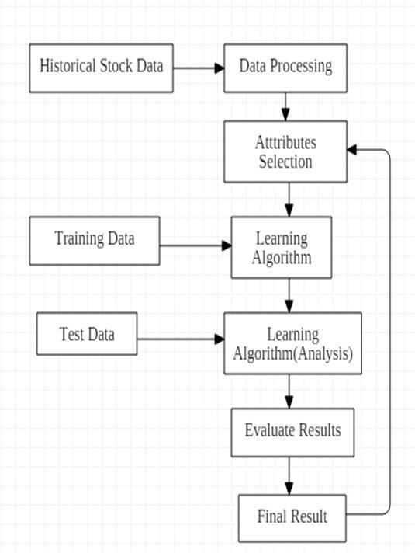
PROPOSED WORK
Collect data from source
Normalize data
Scale data
Create training and testing data set
Train all the modules using training data sets
Test the model and determine source
Predict the stocks using trained model
Compare the best model between algorithm
Save training model
Display model to the website
Show predictions of stock prices

Slide 8
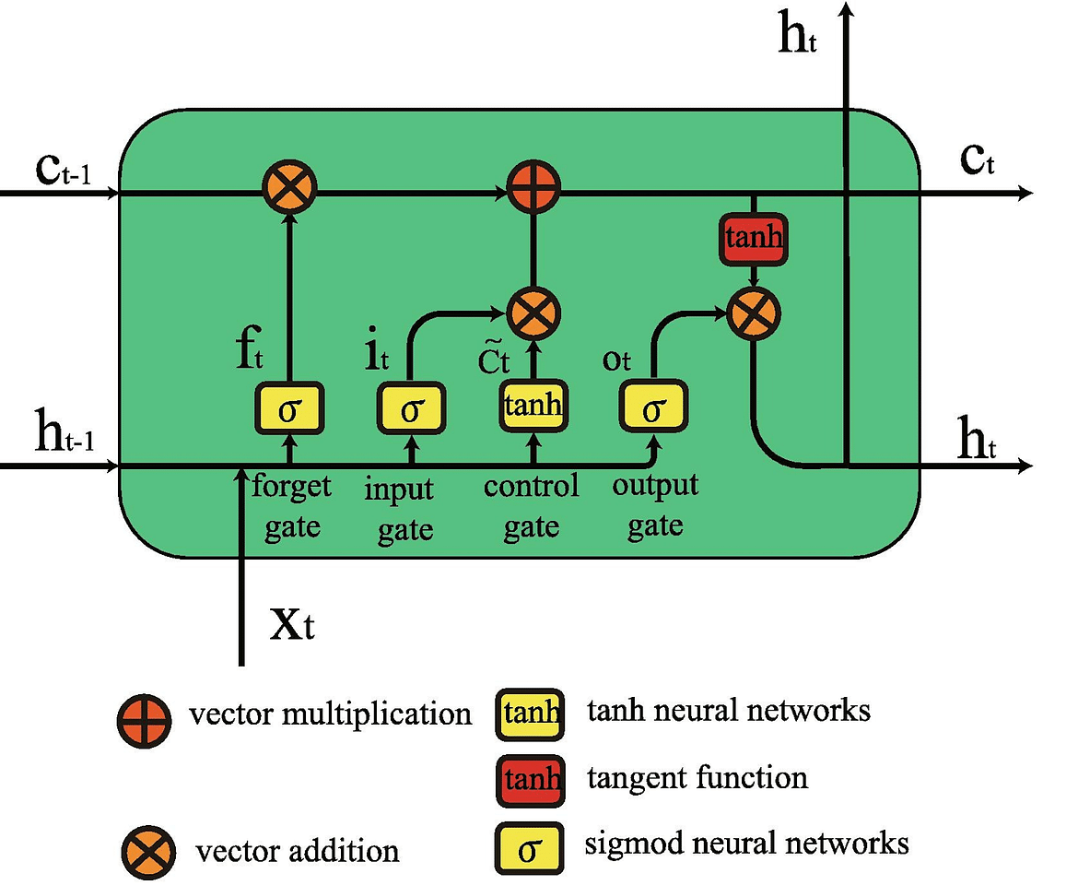
Understanding Long Short Term Memory Network for Stock Price Prediction
LSTM is a Recurrent Neural Network (RNN) that works on data sequences, learning to retain only relevant information from a time window. A standard LSTM cell comprises of three gates: the input, output, and forget gate. This is simple structure is an improvement over the previous and similar RNN model.

Slide 9
REQUIREMENTS
Environment and tools:
Jupyter Notebook
Numpy
Pandas
Seaborn
Matplotlib
Software:
Platform- Windows, Linux or MacOS
Operating System- Window, Linux or MacOS
Technology- Python Machine Learning
Scripting Language- Python
IDE- Jupyter Notebook

Slide 10
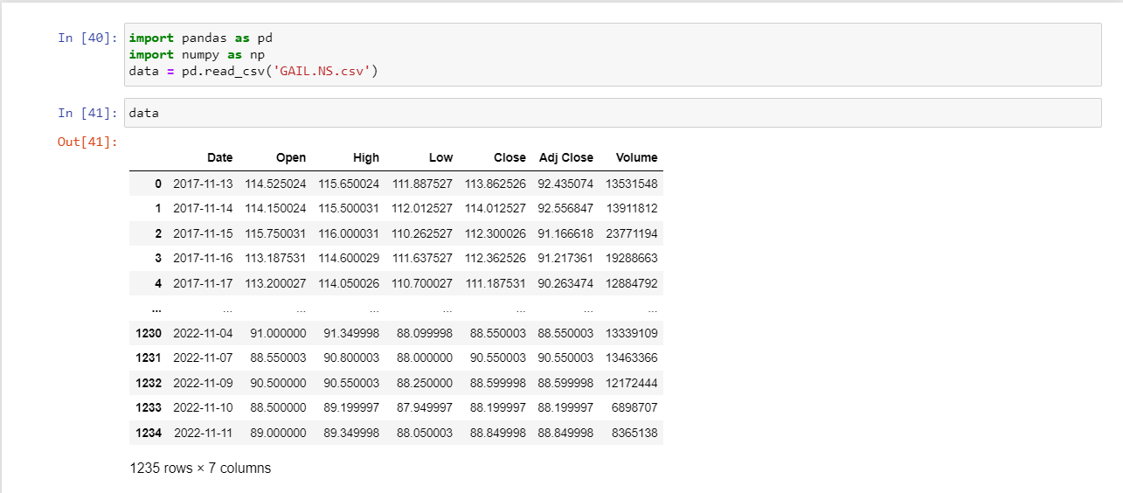
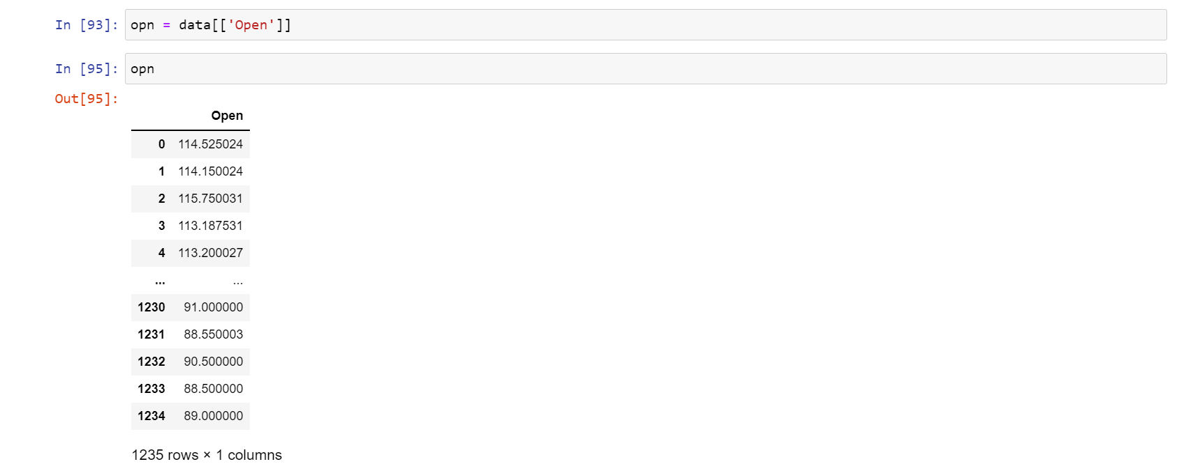
TESTING AND OUTPUT

Slide 12
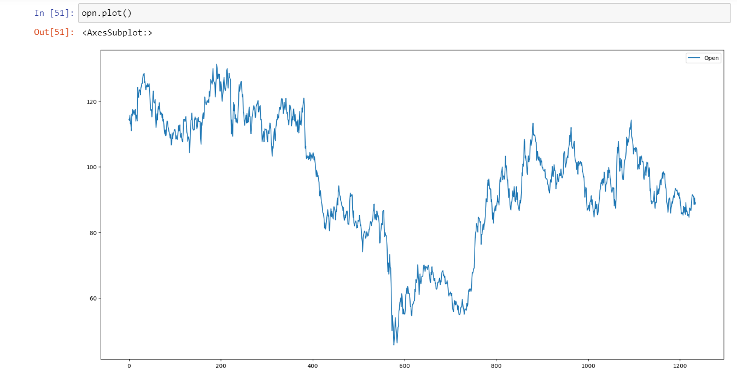

Slide 13
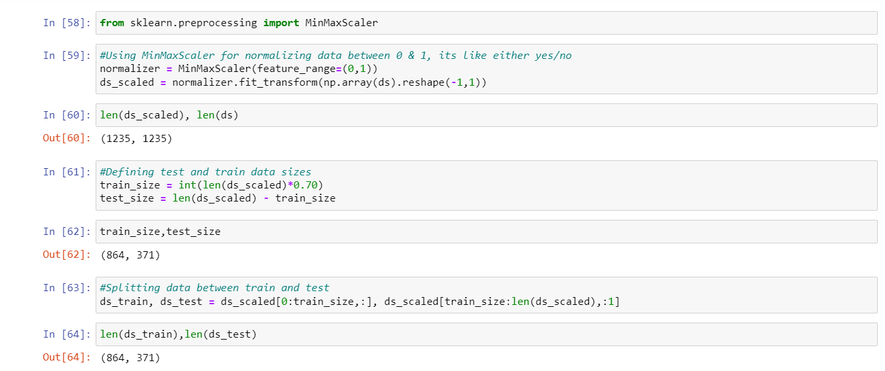

Slide 14
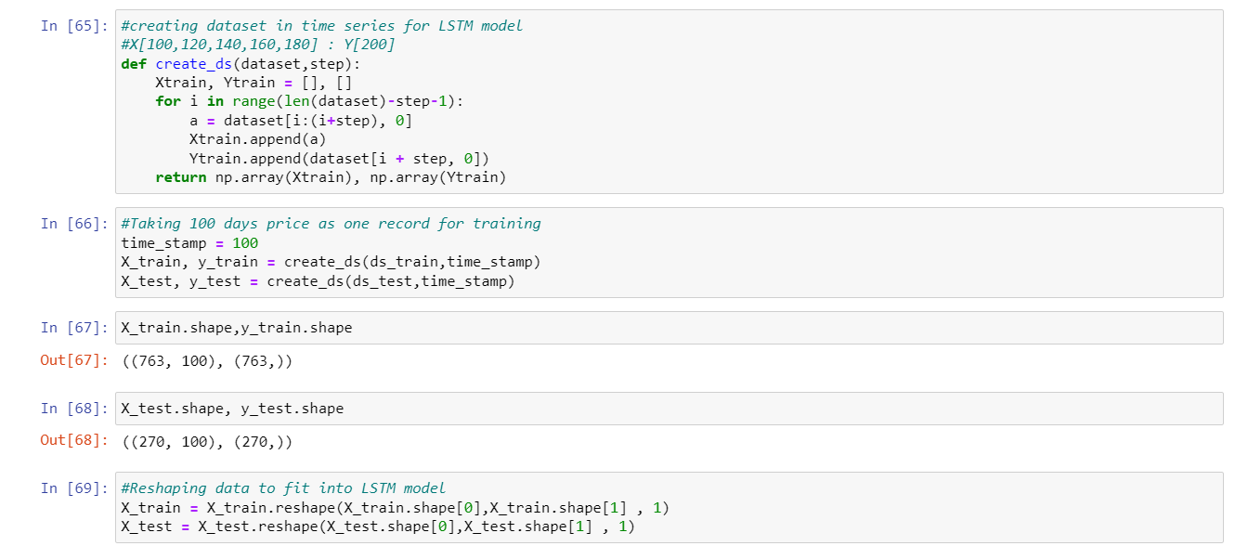

Slide 15
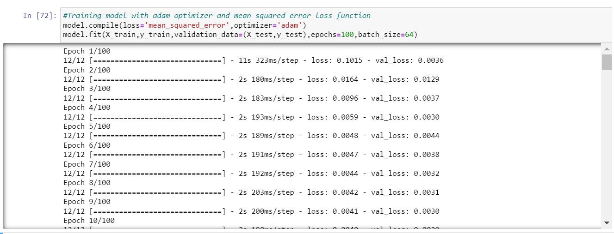

Slide 16
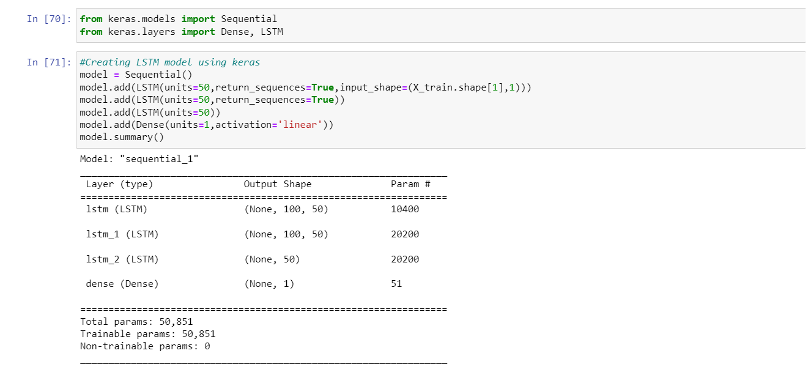

Slide 17
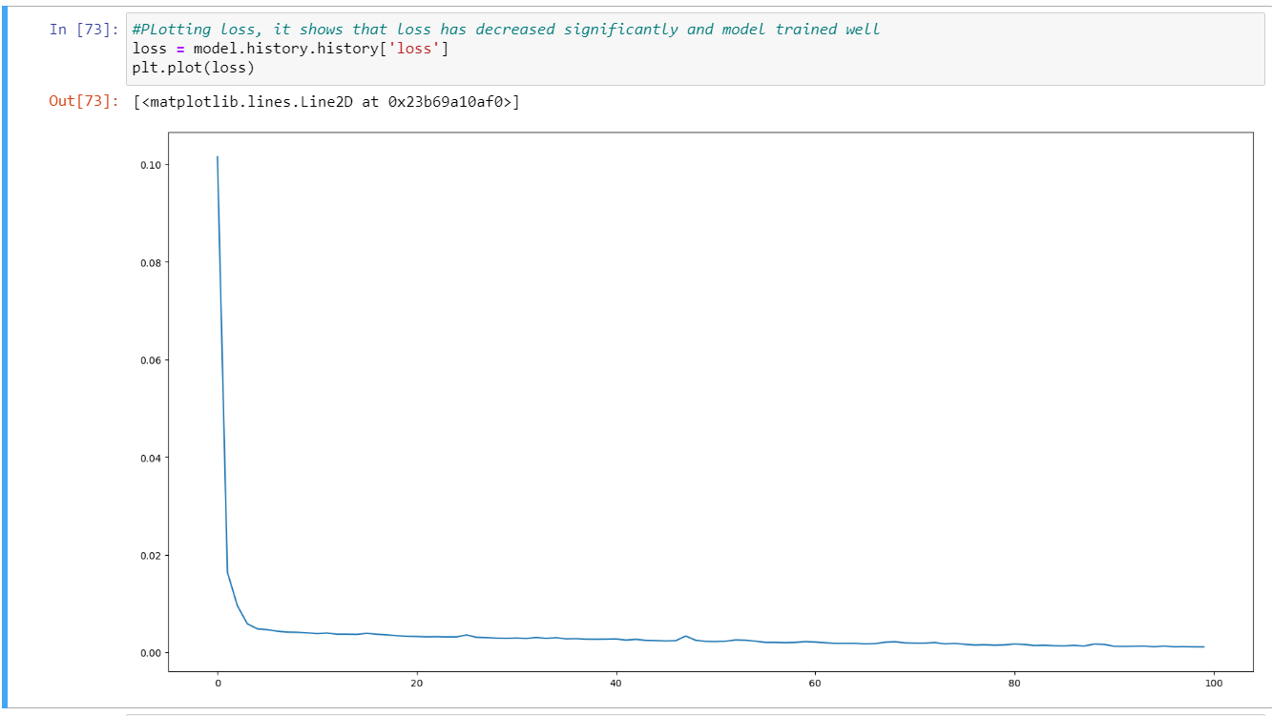

Slide 18
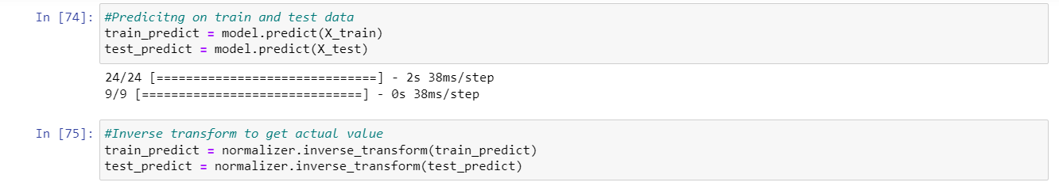
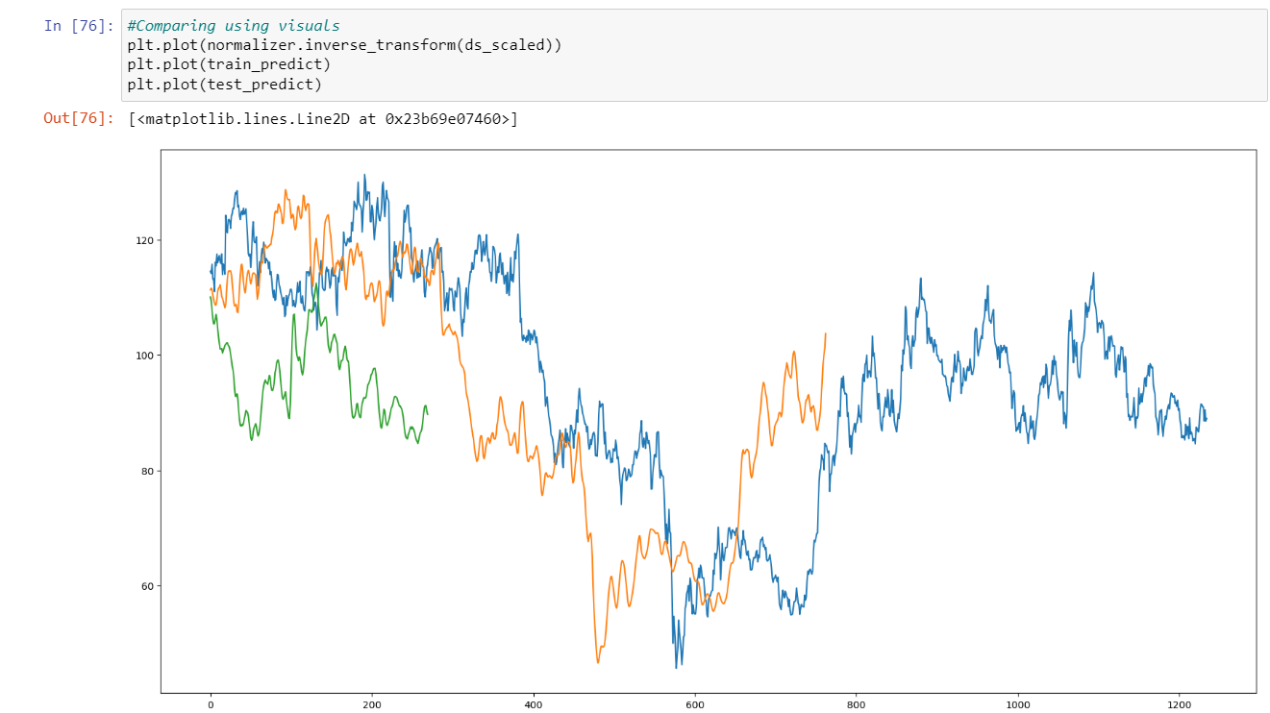

Slide 19
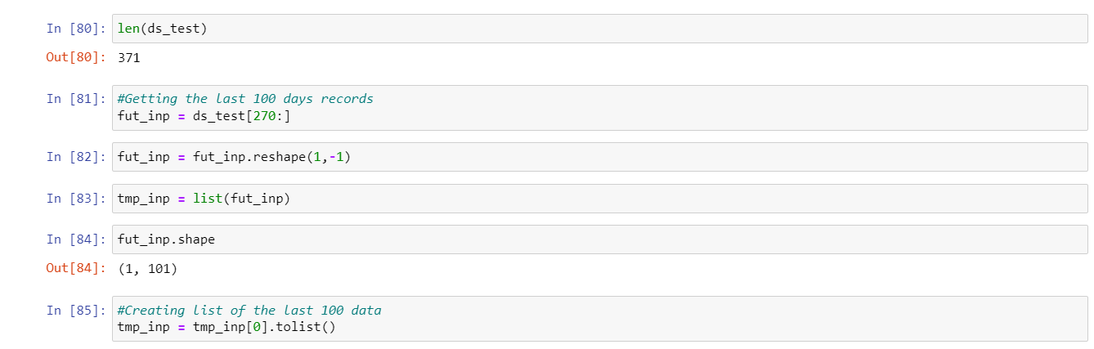
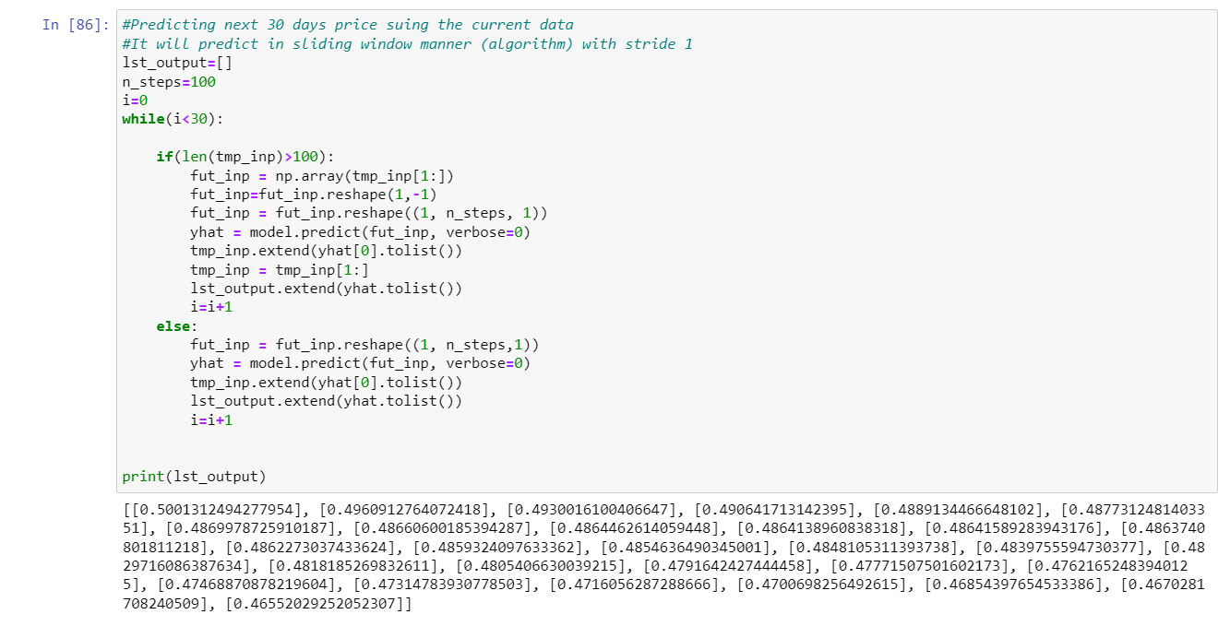

Slide 20
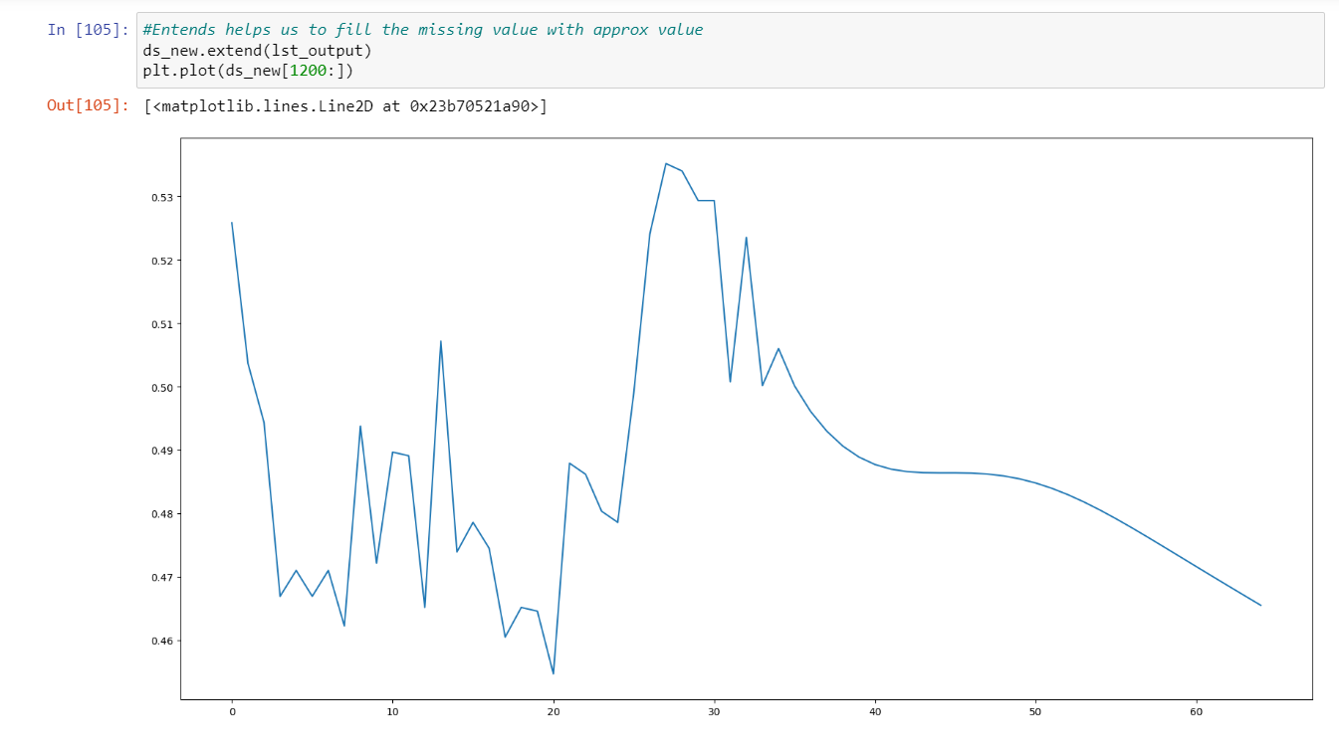

Slide 21
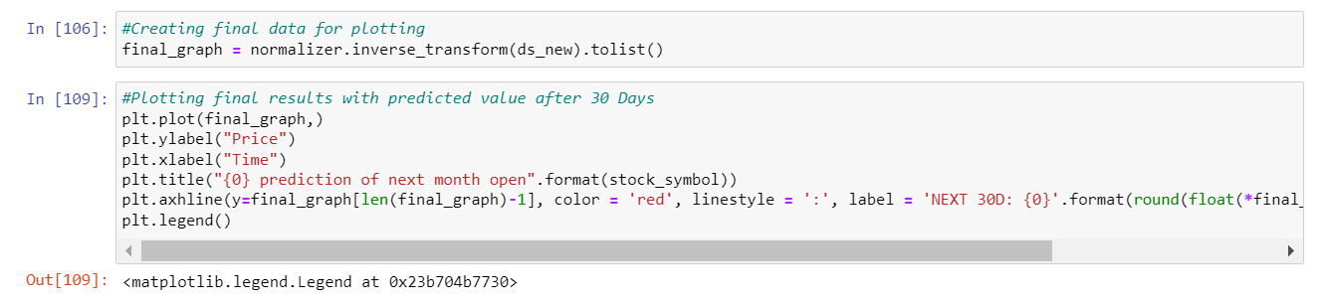
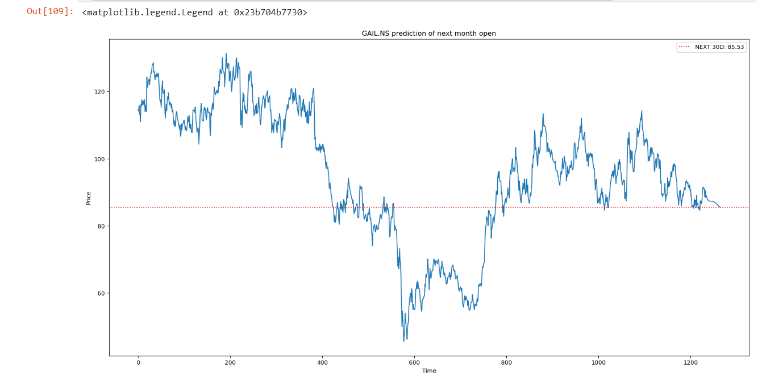

Slide 22
CONCLUSION
By using a multiple linear regression model and logistics model we predicted the stock price value which lead to the conclusion that it is possible to predict stock price with more accuracy and efficiency using machine learning techniques. In the future, the stock price prediction system can be further improved by utilizing a much bigger data set than the one being utilized currently. It would help increase the accuracy of our prediction models
Done by:
20KN1A05B9
20KN1A0596
20KN1A05C1

